Slide 1
Stock Market Infographics
70%
90%
Here is where this template begins
This template has been created by Slidesgo

Slide 2
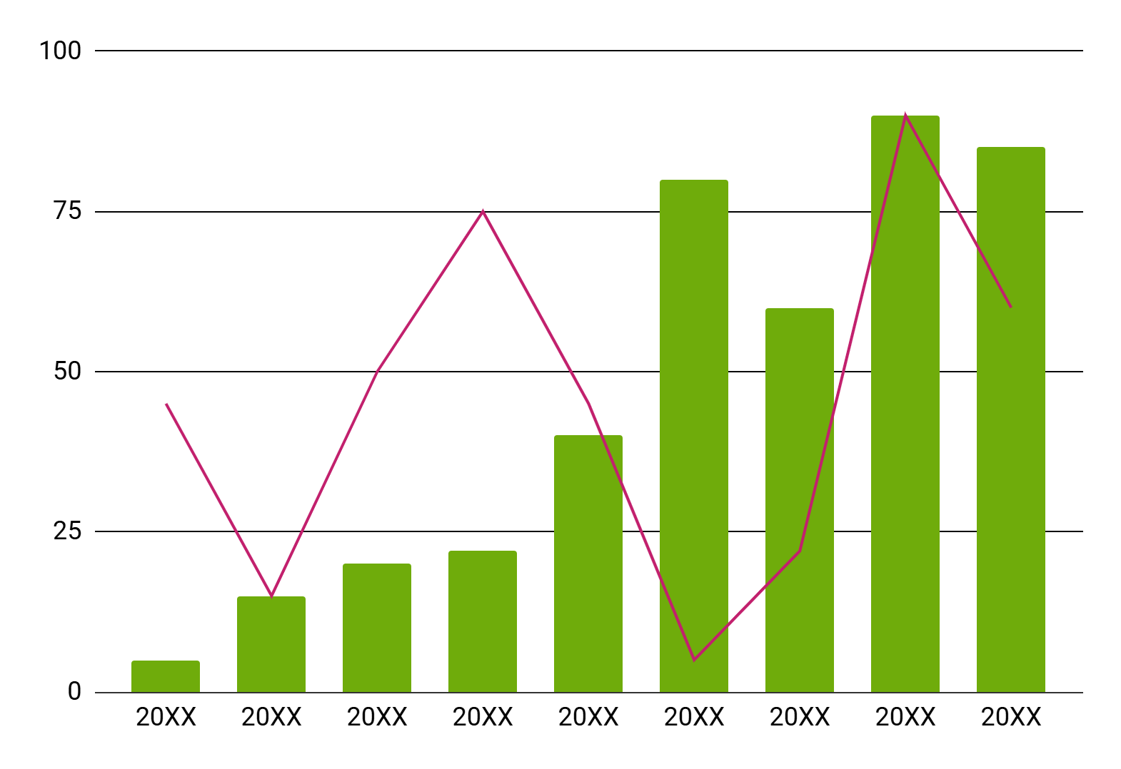
Stock Market Infographics
Mercury
Mercury is the closest planet to the Sun and is very small
Jupiter
Jupiter is a gas giant and has around eighty moons
Follow the link in the graph to modify its data and then paste the new one here. For more info, click here
This template has been created by Slidesgo

Slide 3
Stock Market Infographics
85%
Earth is the third planet from the Sun and the only one with life
Mercury
Earth
Mercury is the closest planet to the Sun and is
very small
40%
This template has been created by Slidesgo

Slide 4
Stock Market Infographics
Venus is the second planet from the Sun
Neptune is far away from us
Mars is full of iron oxide dust
The Moon is Earth’s only natural satellite
Venus
Neptune
Mars
The Moon
Earth
Mercury
Saturn
Jupiter
Earth is the third planet from the Sun
Mercury is the closest planet to the Sun
Saturn was named after a Roman god
Jupiter was named after a Roman god
This template has been created by Slidesgo

Slide 5
Stock Market Infographics
Venus
A
Venus has a beautiful name and is the second planet from the Sun
Jupiter
B
It was named after the Roman god of the skies and lightning
Mars
C
Despite being red, Mars is actually a cold place. It’s full of iron oxide dust
This template has been created by Slidesgo

Slide 6
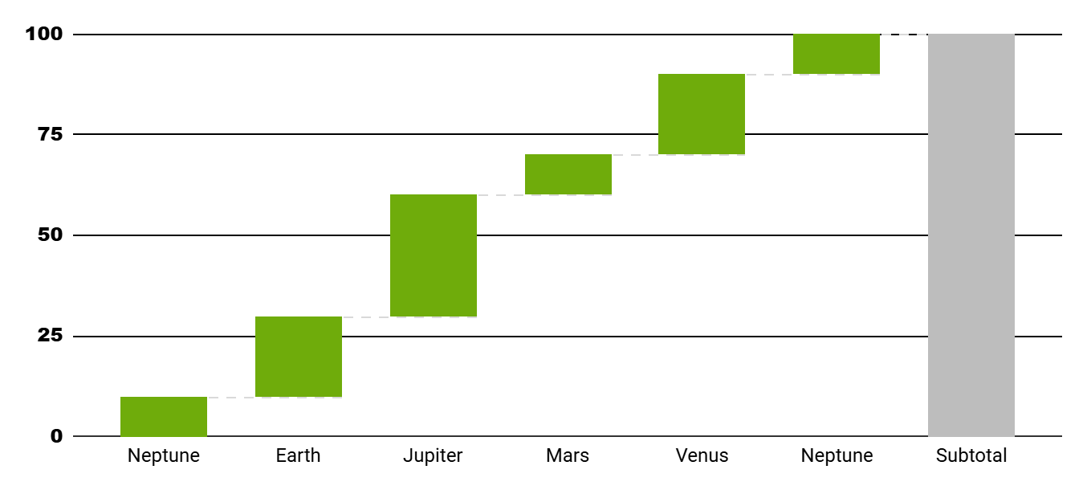
Stock Market Infographics
1
Mars is full of iron oxide dust
2
The Moon is Earth’s only natural satellite
Venus
Follow the link in the graph to modify its data and then paste the new one here. For more info, click here
Venus is the second planet from the Sun
3
Saturn was named after a Roman god
This template has been created by Slidesgo

Slide 7
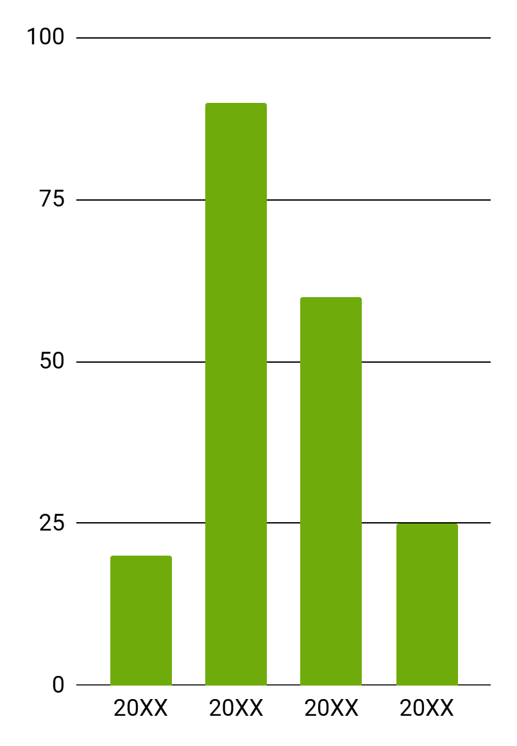
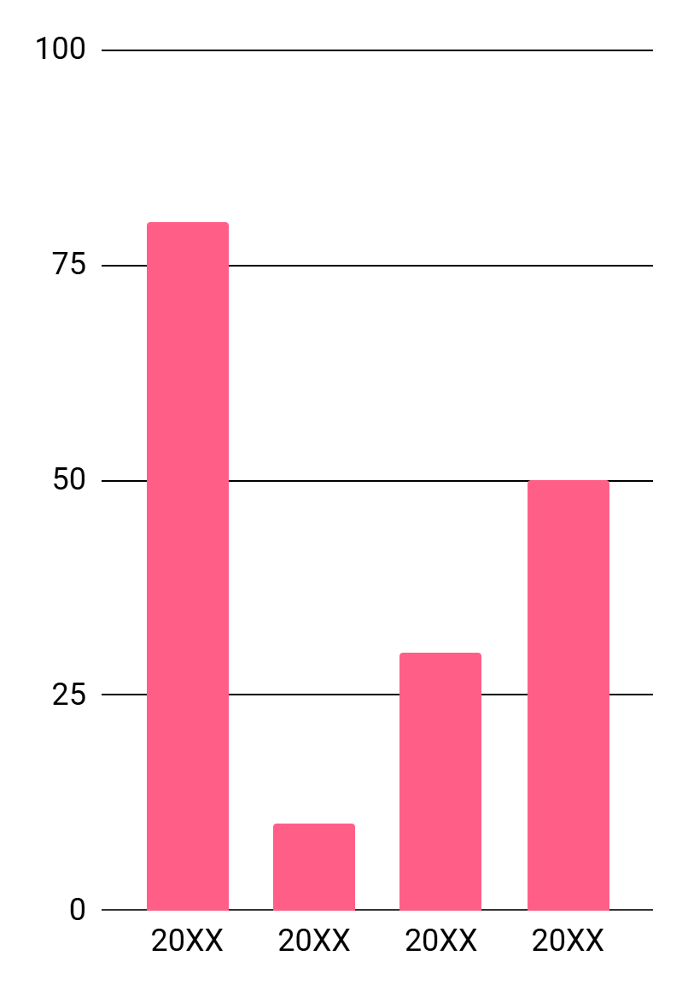
Stock Market Infographics
Venus
Mars
Venus is extremely hot, even more than Mercury
Despite being red, Mars is actually a cold place
Follow the link in the graph to modify its data and then paste the new one here. For more info, click here
This template has been created by Slidesgo

Slide 8
Stock Market Infographics
20XX
Q1
Q2
Q3
Q4
70%
30%
50%
80%
Earth
Mercury
Saturn
Jupiter
Earth is the third planet from the Sun
Mercury is the closest planet to the Sun
Saturn was named after a Roman god
Jupiter was named after a Roman god
This template has been created by Slidesgo

Slide 9
Stock Market Infographics
20XX
20XX
20XX
20XX
Neptune is far away from us
Earth is also known as the Blue Planet
Saturn was named after a Roman god
Jupiter doesn’t have a solid surface
This template has been created by Slidesgo

Slide 10
Stock Market Infographics
Earth
Earth is the third planet from the Sun and the only one that harbors life in the Solar System. All humans live on this planet
A
B
Mercury
Earth
Mercury is the closest planet to the Sun and is
very small
Earth is the third planet from the Sun and the only one with life
This template has been created by Slidesgo

Slide 11
Stock Market Infographics
Mars
25%
75%
Despite being red, Mars is actually a cold place. It’s full of iron oxide dust, which gives the planet its reddish cast
Saturn is a gas giant and has several rings
Neptune is the farthest planet from the Sun
60%
40%
Mercury is the smallest one in the Solar System
Jupiter is the biggest planet in the Solar System
Jupiter
It’s the fourth-brightest object in the night sky. It was named after the Roman god of the skies and lightning
This template has been created by Slidesgo

Slide 12
Icon Pack
This template has been created by Slidesgo

Slide 13
Instructions for use (premium users)
As a Premium user, you can use this template without attributing Slidesgo
You are allowed to:
Modify this template
Use it for both personal and commercial projects
Share this template in an
editable format
Hide or delete the “Thanks” slide and the mention to Slidesgo in the credits
You are not allowed to:
Sublicense, sell or rent any of Slidesgo Content
Distribute Slidesgo Content unless it has been expressly authorized by Slidesgo
Use any of the elements that are part in a separated way
Register any of the elements as a trademark or logo in an intellectual property registry
For more information about editing slides, please read our FAQs or visit our blog

Slide 14
Infographics
You can add and edit some infographics to your presentation to present your data in a visual way.
Choose your favourite infographic and insert it in your presentation using Ctrl C + Ctrl V or Cmd C + Cmd V in Mac
Remember to choose the “Keep source formatting” option so that it keeps the design. For more info, please visit our blog
01
07
Select one of the parts and ungroup it by right-clicking and choosing “Ungroup”
Repeat the steps above with the other parts and when you’re done editing, copy the end result and paste it into your presentation
02
06
03
Change the color by clicking
on the paint bucket
05
Group the elements again by selecting them, right-clicking and choosing “Group”
Then resize the element by clicking and dragging one of the square-shaped points of its bounding box (the cursor should look like a double-headed arrow). Remember to hold Shift while dragging to keep the proportions
04

